Slide 1
Chapter 1: Introduction to Statistics

Slide 2
1
3
2

Slide 3
Learning Outcomes
When you will complete this chapter, you would be able to-
Understand the purpose of statistics.
Know the differences between descriptive and inferential statistics.
Understand the differences between a sample and a population.

Slide 4
Contents
From this lecture, you are going to learn…
Statistics and types of statistics
Population and sample
Parameter and statistic
Sampling Techniques

Slide 5
What is Statistics?
“Statistics is a way to get information from data”
Statistics
Data
Information
Statistics is a tool for creating new
understanding from a set of numbers.
Definitions: Oxford English Dictionary

Slide 6


What is Statistics?
STATISTICS is the science of collecting, organizing, presenting, analyzing, and interpreting data to assist in making more effective decisions.
Collect
Gathering of facts or data
Organize
Arranging data for the presentation
Present
Summarizing data in textual, graphical, or tabular forms.
Analyze
Describing the data by using statistical methods and procedures.
Interpret
Making conclusions based on the analyzed data.
1-6

Slide 7
Branches of Statistics or Types of Statistics
Statistics
Descriptive Statistics
Inferential Statistics

Slide 8


Branches of Statistics or Types of Statistics
Descriptive Statistics Involves organizing, summarizing, and displaying data.
e.g. Tables, charts, averages .
Inferential Statistics Involves using sample data to draw conclusions about a population.
a
Aa

Slide 9
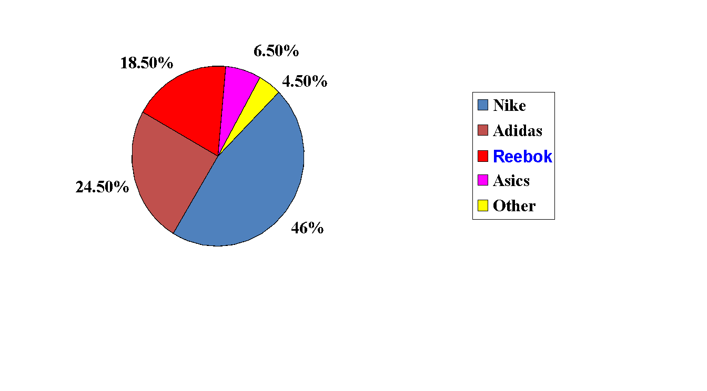
Descriptive Statistics
EXAMPLE : Pie Chart For showing favorite type of running shoes of 200 runners.

Slide 10
Inferential Statistics
Example:
The accounting department of a large firm will select a sample of the invoices to check for accuracy for all the invoices of the company.

Slide 11
Exercise: Descriptive Vs Inferential Statistics
A follow up study was conducted among male who were aged 48, for 18 years. For men who took unhygienic food, approximately 70% were alive at age 65. For men who took hygienic food, 90% were alive at age 65.
For this example
Descriptive Statistics
For men who took unhygienic food, approximately 70% were alive at age 65.
For men who took hygienic food, 90% were alive at age 65.
A possible conclusion that means Inference is:
Taking hygienic food is associated with a longer life for men.

Slide 12
Population VS Sample
Population:
The collection of all possible individuals, objects, or measurements of interest.
Sample:
Representative part of the population
“ALL”
“SOME”
Example:
Population – Total number of DIU students during the year 2011
Sample – Few selected students of DIU during the year 2011

Slide 13
Census,
Parameter VS Statistic
Census: Collection of data from every member of a population.
Parameter: measurable characteristic of a population. It is usually referred to true or actual value.
Example: average CGPA from all the DIU students.
Statistic: measurable characteristic of a sample.
Example: average CGPA from few students of DIU

Slide 14
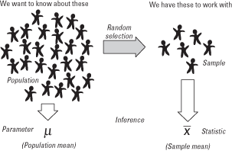
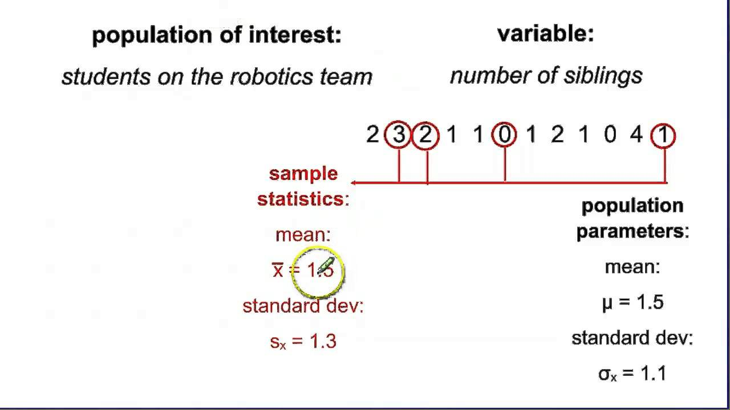
Population, Sample, Parameter, Statistic
At a glance….

Slide 15
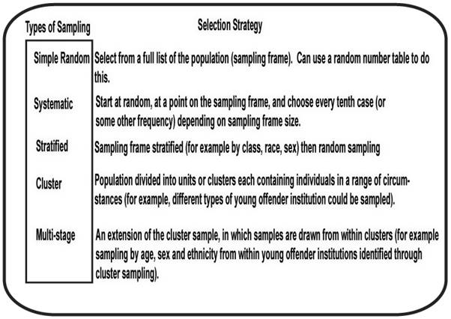
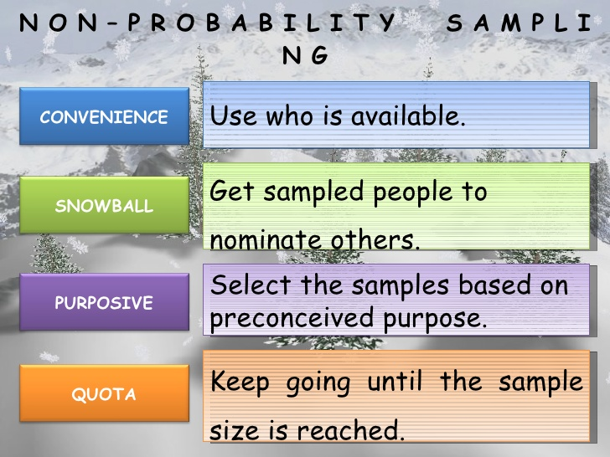
Sampling Techniques
Probability Sampling

Slide 16


